Slide 1
Debugging Techniques
AI Tech – Intro

Slide 2
Overview
Bug Types
Debugging Techniques
Debugging Strategies

Slide 3
Bug Types

Slide 4
Bug Types – Overview
Bugs often overlap categories
Main families: Syntax / Compile-Time, Runtime, Logic

Slide 5
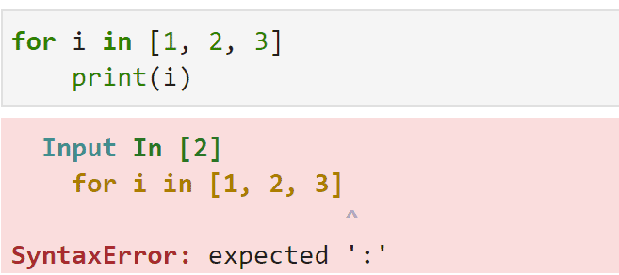
Syntax / Compile-Time Bugs
Stop code from compiling or running
Examples: missing semicolons, bad imports
Fix by correcting code & build settings
Tools: linters, build logs, static analyzers

Slide 6
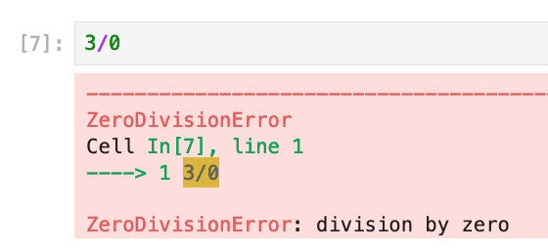
Runtime Bugs – Part 1
Appear during program execution
Unhandled exceptions crash the app
Examples: NullReference, IndexError, KeyError
Use stack traces, try/catch, and context logging

Slide 7
Runtime Bugs – Part 2
Data issues: invalid or missing input
Memory problems: leaks, buffer overruns
Concurrency issues: deadlocks, races
Use input validation, sanitizers, and lock timeouts

Slide 8
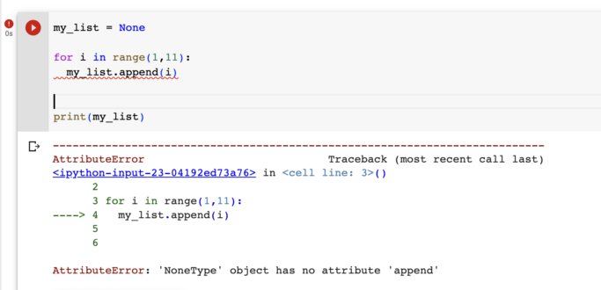

Slide 9
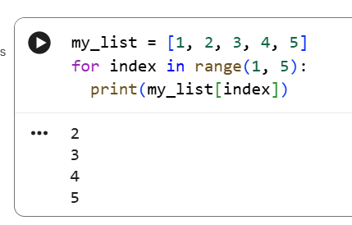
Logic Bugs – Part 1
Program runs but produces wrong result
Off‑by‑one errors and counting mistakes
Fix: explicit loop bounds, use iterators

Slide 10
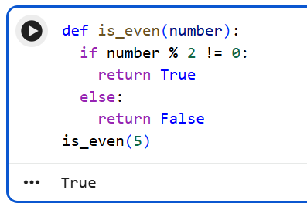
Logic Bugs – Part 2
Improper branching: wrong conditions or misplaced else
Concurrency logic errors: bad ordering assumptions
Domain‑specific mistakes: business rule misinterpretation
Add tests and validate rules with stakeholders

Slide 11
Debugging Techniques

Slide 12
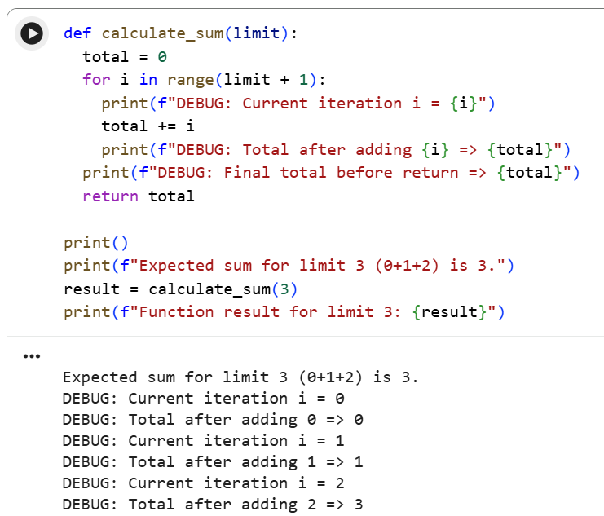
Debugging Techniques – Print & Interactive
Print‑statement debugging to see state changes
Add IDs/timestamps to logs for correlation
Interactive debugging: breakpoints and watch expressions

Slide 13
Debugging Techniques – Tests & Examples
Test‑driven isolation: write failing test before fix
Keep the test to prevent regressions
Reproduce minimal example: small, clear snippet

Slide 14
Profiling & Log Analysis
Profilers: CPU, memory, I/O, lock contention
Record under normal load → find hotspots
Centralize logs and add structured fields
Set alerts for spikes or anomalies

Slide 15
Debugging Strategies

Slide 16
Core Debugging Strategies – Basics
Start: 'Something bad happened' → look for bad data or logic
RTFE: Read the error carefully first
Form simple hypotheses and test them early

Slide 17
Core Debugging Strategies – Narrow & Expand
Divide‑and‑conquer to reduce search space
Run minimal input/code reproductions
Expand scope to dependencies if needed

Slide 18
Questions

